Slide 1

WELCOME

Slide 2

SRI PADMAVATHI MAHILA VISVAVIDYALAYAM
TIRUPATI
DEPARTMENT OF STATISTICS

Slide 3
EXPLORATORY DATA ANALYSIS ON OTT MEDIA
USING ML TOOL

Slide 4
PROJECT CONTENTS:
Introduction
Objective
Methodology
Software
Experimental Results
Conclusion
Reference

Slide 5
INTRODUCTION
OTT (Over The Top) :
OTT Platforms stands for Over The Top Platforms with the diverse taste and preference of the people. OTT Platforms have become popular these days. Those days are gone when people rely on Television to broadcast their favourite show. People nowadays subscribe to OTT platforms. Users select the genre they like and start watching the content of their choice. The covid-19 pandemic and lockdown have forced people to stay at home. With colleges, offices, and theatres shut down; people rely completely on the OTT platforms for entertainment.

Slide 6
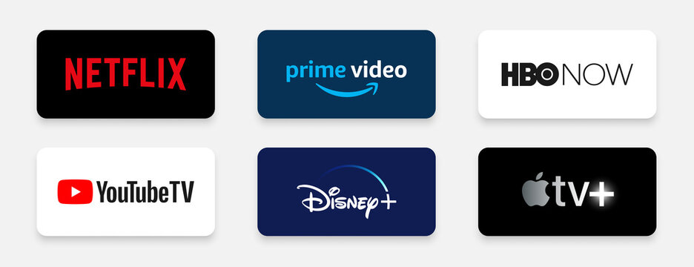
WHAT IS OTT PLATFORM ?
OTT platforms stream audio and video services through the internet. Many of the OTT platforms offer some content for free and charge some content. The user has to buy a subscription to the charged content to be able view it. Subscription is usually charged for content unique to the platform which is not available on the other platforms.

Slide 7
HISTORY OF OTT PLATFORMS IN INDIA:
OTT platforms started in India with BigFlix. Launched by Reliance Entertainment in 2008, BigFix became India's first OTT platform. Eventually, OTT started thriving in India in 2013 after the launch of Zee TV and Sony Liv. Disney hotstar came into the OTT world in 2015. Viewers of Disney hotstar are increasing since its launch. Today, it has become one of the most-watched OTT platforms. Later, Netflix began providing its service in India from the beginning of 2016 and competing with the platforms like Amazon-Prime Video and Disney+hotstar.

Slide 8
OBJECTIVES
To Measure the Pattern of use of OTT platforms among society.
To determine the Factors influencing the use of OTT platforms.
To Recognise popular OTT platforms and content preference of viewers in OTT platforms.
To understand the experience of OTT platforms.

Slide 9
METHODOLOGY
Enter the data in Excel and save it.
In R-studio can import the data by click on import dataset from excel Browse the data
import.
In R-studio provides a built-in view () function that opens a spreadsheet-like viewer for the dataset, allowing you to explore it interactively.
Use the summary () function to generate basic summary statistics (minimum, 1st quartile, median, mean,3rd quartile, maximum) for a data frame.
Use the pie () function to create the pie chart. We can customize the appearance of the pie chart by adding parameters to the pie () function.
Col -Specify a vector of colors for each slice.

Slide 10
Main -Add a title to your pie chart.
Legend -This code adds a legend to the top-right corner of the plot with labels and corresponding colors.
Use the bar plot () function to create a bar chart in R. We can customize the appearance of bar chart by adding parameters to bar plot ()
Col- Specify a vector of colors for the bars.
Main- Add a title to your bar chart
X-Lab & Y-Lab- Label the x and y axes.
Horiz- Create a horizontal bar chart instead of a vertical one.
Legend- Create a legend to explain the color-coding.
In R-studio, you can perform a chi-square test using the chisq.test() function to determine if there is an association between to categorical variables.

Slide 11
DATA COLLECTION
The data is carried out in the form of google sheet. This data set having 300 samples collected from different age groups including students, working professionals and unemployees.
https://forms.gle/NF472EXzhd2Xc7Gv5

Slide 12
ABOUT THE SOFTWARE
R is a programming language and open-source software environment primarily used for statistical computing and data analysis. Here are some key aspects of R programming software:
Open source: R is distributed under the GNU General Public License (GPL), which means it is free to use, modify, and distribute. This open-source nature has contributed to its widespread adoption and the development of a rich ecosystem of packages and libraries.
Statistical Computing: R was developed by statisticians and is designed with a strong focus on statistical analysis and data visualization. It provides a wide range of statistical and graphical techniques for data analysis.
Packages and Libraries: R has a vast repository of packages and libraries that extend its capabilities. These packages cover various areas, such as data manipulation, machine learning, time series, spatial analysis, and more. The Comprehensive R Archive Network (CRAN) is the primary repository for R packages.

Slide 13
Data Manipulations: R excels at data manipulations and transformation. It offers powerful data structures like data frames and tools for data cleaning, reshaping, and merging.
Data Visualization: R provides extensive tools for data visualization, including the popular GGplot2 package. You can create a wide range of static and interactive plots and charts for data exploration and presentation.
Data Import and Export: R can handle various data formats, including CSV, Excel, SQL databases, JSON, and more. This flexibility makes it easy to import and export data from different sources.
Cross-Platform: R is available for various platforms, including Windows, macOS, and Linux, making it accessible to a wide range of users.
Data Science and Machine Learning: R has gained popularity in the field of data science and machine learning due to its extensive libraries for these purposes. Packages like caret, randomForest, and xgboost are widely used for predictive modeling.

Slide 14
Reproducibility: With R, you can create reproducible research workflows by using tools like R Markdown and version control systems, ensuring that your analysis can be easily shared and reproduced.
In summary, R is a versatile and powerful programming language and software environment for statistical computing and data analysis. Its open-source nature, extensive package ecosystem, and active community support make it a valuable tool for researchers, data analysts, and data scientists.

Slide 15
R-CODE FOR PIE CHART
x<-table(Age)
labels<-c("under18","18-24","25-30","30&Above")
piepercent<round(100*x/sum(x),1)
pie(x,labels=piepercent,main="AGELIMIT",col=rainbow(length(x)))
legend("topright",labels,cex = 0.5,fill = rainbow(length(x)))
box()

Slide 16
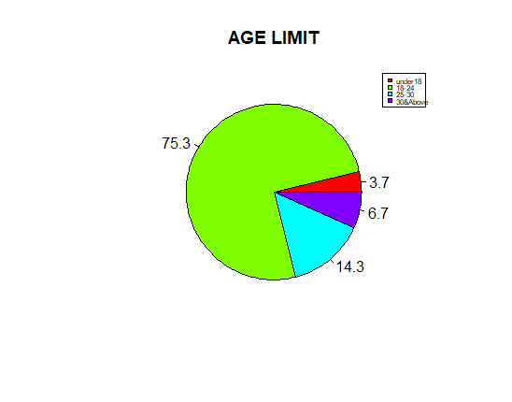
EXPERIMENTAL RESULTS
VISUALIZATION OF DATA
In the above chart we can see that highest percentage of 75.3% belongs to 18-24 age group and lowest percentage of 3.7%belongs to Under 18 age group

Slide 17
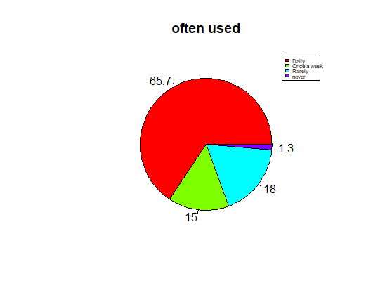
How often do you use online platforms for entertainment?
In the above chart we can see that most of them use OTT daily with highest percentage of 65.7% and some never use with percentage of 1.3%.

Slide 18
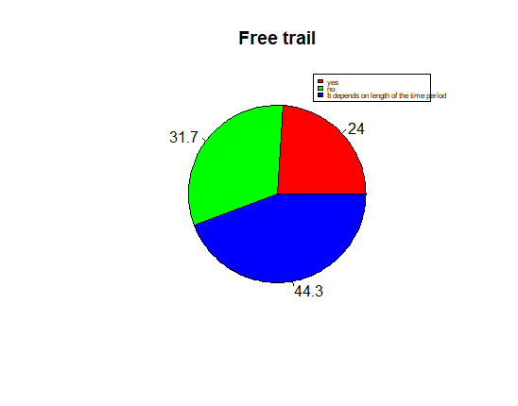
Will you subscribe to an online platform if it offers a free trail period?
In the above chart we can see that many try the free trail when it depends on the length of the time period with 44.3%.

Slide 19
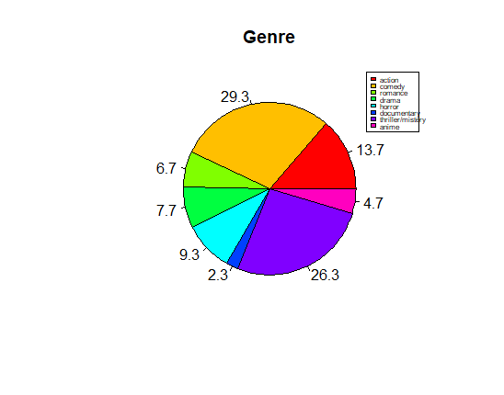
Which genre of content do you prefer on OTT?
In the above chart the mostly watched genre is COMEDY with 29.3% and least watched genre is DOCUMENTARY with 2.3%.

Slide 20
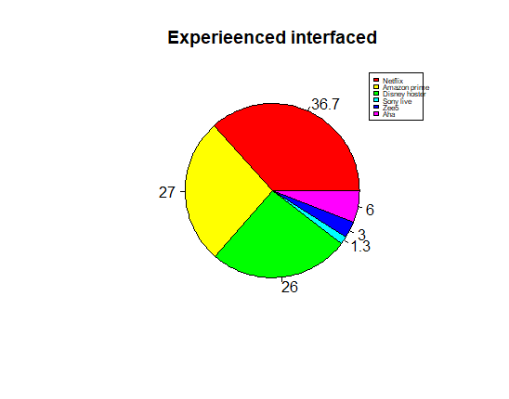
Which OTT platform provides the best user experience and interface?
In the above chart NETFLIX provides the best interface with 36.7% and SONY LIV doesn’t provide the best interface with 1.3%.

Slide 21
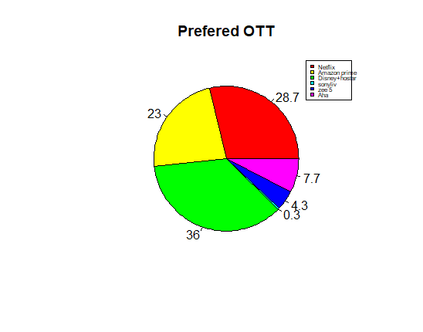
Which OTT platform will you use for entertainment?
In the above chart the mostly used OTT is DISNEY+HOTSTAR with 36% and least used OTT is SONY LIV with 0.3%

Slide 22
R-CODE FOR BARPLOT
a2<-table(Factors)
b2<-c("Price","content","Multipledevice","All")
barp<-barplot(a2,names.arg = b2,xlab="values",ylab = "count",main="Factors",col="skyblue",ylim = c(0,300),las=1)
piepercent<-round(100*a2/sum(a2),1)
text(barp,a2,labels=piepercent)

Slide 23
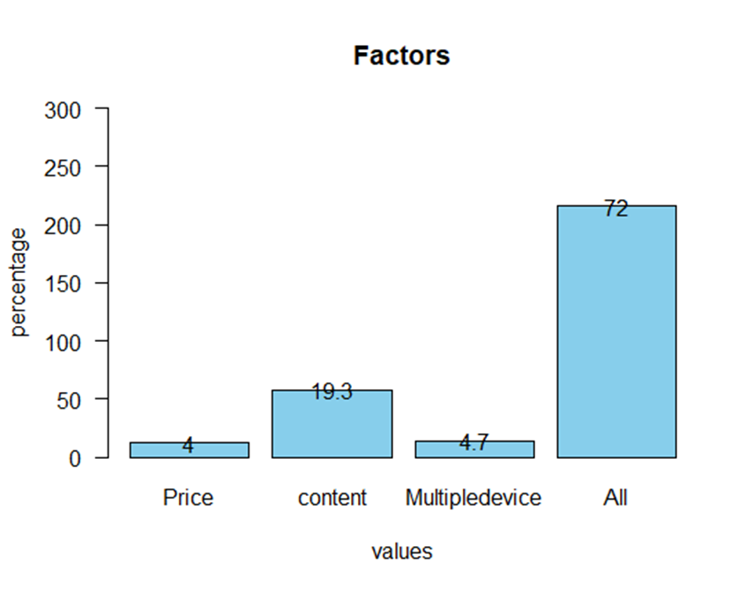
What factors are most important to you while choosing an online platforms for entertainment?
In the above chart the mostly influenced Factors are price, content and usage in multiple devices with 72%.

Slide 24
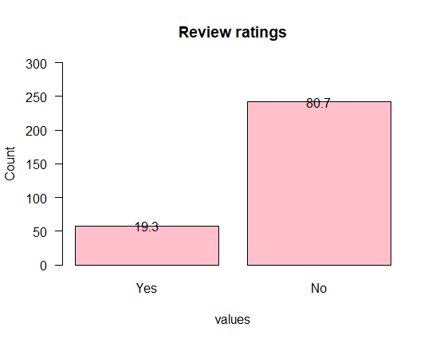
Do you prefer user reviews and ratings while subscribing to an online platforms?
In the above chart 19.3% people prefer user reviews and ratings while subscribing to an online platform.

Slide 25
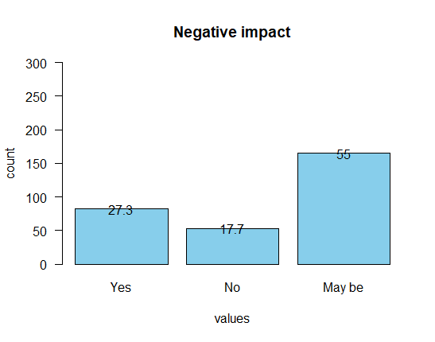
Do you think OTT platforms create negative impact on television/cable services?
In the above chart 27.3% respondents think OTT platform create negative impact on television/cable services. Remaining 55% think they may create negative impact on the Television whereas 17.7% think it doesn’t create any negative impact.

Slide 26
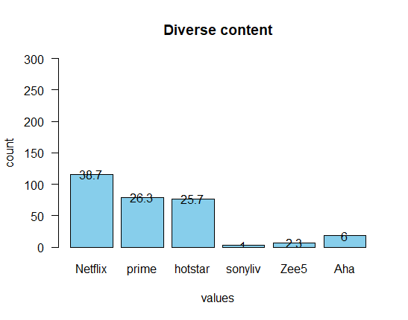
Which OTT platforms offers the most diverse content selection?
In the above chart 38.7% of the respondent preferred Netflix is the OTT platform offers the most diverse content selection, the next one comes under is Prime with 26.3%, the very next one is Disney+hostar with 25.7% whereas sonyliv is the least used with 1%

Slide 27
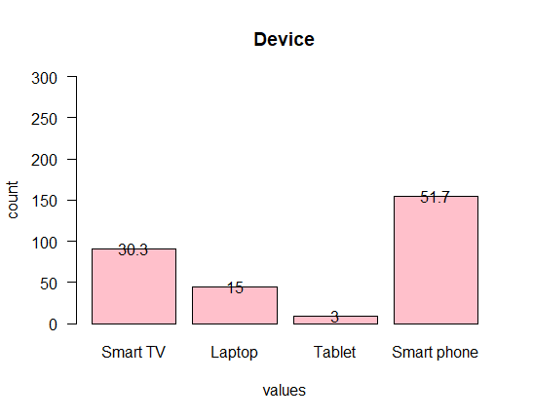
On which device do you prefer to watch an OTT platform?
In the above chart 51.7% of respondents prefer Smart phone to watch an OTT platform, 30.3% of respondents prefer Smart Tv to watch an OTT platform when least with 3% prefer to watch on tablet

Slide 28
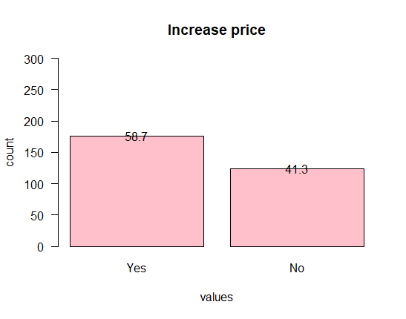
Will you continue using an OTT platform if it increases subscription price?
In the above chart 58.7% of respondents will continue using an OTT platform even if it increases subscription price.

Slide 29
R-CODE FOR DESCRIPTIVE STATISTICS
summary(Often_used)
R-CODE FOR STANDARD DEVIATION
sd(Often_used)
R-CODE FOR CHI-SQUARE
chisq.test(Age,Often_used)

Slide 30
Variables | Mean ± SD
Often used | 1.55± 0.830
Free trail | 2.203±0.802
Parental control | 1.773±0.419
Review rating | 1.807±0.395
Factors | 3.447±0.936
Negative impact | 2.277±0.865
Find genre | 1.82±0.384
Diverse content | 2.2±1.348
Preferred OTT | 2.517±1.420
Genre | 4.053±2.406
Extra pay | 2±0.936
Content | 2.557±0.740
Experience interface | 2.25±1.361
Documentaries | 2.207±1.335
Downloads | 1.833±0.735
Recommend | 1.79±0.829
Device | 2.76±1.352
Sports live | 1.447±0.497
Increase price | 1.413±0.493
Technical issue | 1.603±0.490
Slow internet | 1.983±0.827
Rating | 4.08±0.892

Slide 31
s.no | VARIABLES |  | AGE |  |  |  |  |  |  |  | CHI-SQUARE | P VALUE
 |  |  | Under18 |  | 18-24 |  | 25-30 |  | 30&above
 |  |  | F | % | F | % | F | % | F | %
1. | Factors | Price | 0 | 0% | 10 | 3.3% | 1 | 0.3% | 1 | 0.3% | 8.2902 | 0.5052
 |  | Content | 2 | 0.3% | 43 | 14.3% | 11 | 3.6% | 2 | 0.3%
 |  | Devices | 0 | 0% | 9 | 3% | 2 | 0.3% | 3 | 1%
 |  | All the above | 9 | 3% | 164 | 54.6% | 29 | 9.6% | 14 | 4.6%
2. | Genre | Action | 2 | 0.6% | 28 | 9.3% | 7 | 2.3% | 4 | 1.3% | 22.98 | 0.345
 |  | Comedy | 1 | 0.3% | 66 | 22% | 12 | 4% | 9 | 3%
 |  | Romance | 0 | 0% | 16 | 5.3% | 3 | 1% | 1 | 0.3%
 |  | Drama | 0 | 0% | 19 | 6.3% | 3 | 1% | 1 | 0.3%
 |  | Horror | 4 | 1.3% | 21 | 7% | 2 | 0.6% | 1 | 0.3%
 |  | Documentary | 1 | 0.3% | 4 | 1.3% | 1 | 0.3% | 1 | 0.3%
 |  | Thriller | 2 | 0.6% | 62 | 20.6% | 12 | 4% | 3 | 1%
 |  | Anime | 1 | 0.3% | 10 | 3.3% | 3 | 1% | 0 | 0%
3. | Diverse content | Netflix | 8 | 2.6% | 88 | 29.3% | 15 | 5% | 5 | 1.6% | 20.901 | 0.14
 |  | Prime | 2 | 0.6% | 60 | 20% | 13 | 4.3% | 4 | 1.3%
 |  | Hotstar | 0 | 0% | 59 | 19.6% | 11 | 3.6% | 7 | 2.3%
 |  | Sony live | 0 | 0% | 2 | 0.6% | 0 | 0% | 1 | 0.3%
 |  | Zee 5 | 1 | 0.3% | 6 | 2% | 0 | 0% | 0 | 0%
 |  | Aha | 0 | 0% | 11 | 3.6% | 4 | 1.3% | 3 | 1%
4. | Recommend | Most likely | 5 | 1.6% | 87 | 29% | 13 | 4.3% | 10 | 3.3% | 4.9501 | 0.5502
 |  | Neutral | 5 | 1.6% | 120 | 40% | 24 | 8% | 10 | 3.3%
 |  | Never | 1 | 0.3% | 19 | 6.3% | 6 | 2% | 0 | 0%
5. | Increase price | Yes | 5 | 1.6% | 135 | 45% | 25 | 8.3% | 11 | 3.6% | 1.0139 | 0.7979
 |  | No | 6 | 2% | 91 | 30.3% | 81 | 27% | 9 | 3%
The above table reveals
that there was significant
among the Age with
Factors, Genre, Diverse content,
Recommendations and Increase
of price of the respondents as
all the p values are greater than
0.05(p>0.05).

Slide 32
S.No | VARIABLES |  | GENDER |  |  |  | CHI SQUARE | P-VALUE
 |  |  | Female |  | Male
 |  |  | F | % | F | %
1. | Factors | Price | 7 | 2.3% | 5 | 1.6% | 3.4798 | 0.3234
 |  | Content | 34 | 11.3% | 24 | 8%
 |  | Devices | 6 | 2% | 8 | 2.6%
 |  | A.O.B | 141 | 47% | 75 | 25%
2. | Genre | Action | 15 | 5% | 26 | 8.6% | 19.589 | 0.00653
 |  | Comedy | 58 | 19.3% | 30 | 10%
 |  | Romance | 15 | 5% | 5 | 1.6%
 |  | Drama | 19 | 6.3% | 4 | 1.3%
 |  | Horror | 17 | 5.6% | 11 | 3.6%
 |  | Documentary | 3 | 1% | 4 | 1.3%
 |  | Thriller | 53 | 17.6% | 26 | 8.6%
 |  | Anime | 8 | 2.6% | 6 | 2%
3. | Diverse content | Netflix | 75 | 25% | 41 | 13.6% | 1.7331 | 0.8847
 |  | Prime | 45 | 15% | 34 | 11.3%
 |  | Hotstar | 50 | 16.6% | 27 | 9%
 |  | Sony liv | 2 | 0.6% | 1 | 0.3%
 |  | Zee 5 | 5 | 1.6% | 2 | 0.6%
 |  | Aha | 11 | 3.6% | 7 | 2.3%
4. | Recommend | Most likely | 71 | 23.6% | 44 | 14.6% | 5.736 | 0.05681
 |  | Neutral | 106 | 35.3% | 53 | 17.6%
 |  | Never | 11 | 3.6% | 15 | 5%
5. | Increase price | Yes | 124 | 41.3% | 52 | 17.3% | 10.248 | 0.001368
 |  | No | 64 | 21.3% | 60 | 20%

Slide 33
The above table reveals that there was significant between the Gender with Factors with P value (0.3234) and with Diverse content of respondents with p value (0.8847) which is greater than 0.05(p>0.05), other variables are not significant. Because that there is no association between the Gender related to Genre, Recommendations and Increase in price.

Slide 34
S. No | DEMOGRAPHIC VARIABLES |  | OCCUPATION |  |  |  |  |  |  |  | CHI-SQUARE | P-VALUE
 |  |  | Student |  | Employee |  | Unemployes |  | Other
 |  |  | F | % | F | % | F | % | F | %
1. | Factors | Price | 8 | 2.6% | 3 | 1% | 0 | 0% | 1 | 0.3% | 14.439 | 0.1075
 |  | Content | 35 | 11.6% | 16 | 5.3% | 3 | 1% | 4 | 1.3%
 |  | Devices | 5 | 1.6% | 5 | 1.6% | 0 | 0% | 4 | 1.3%
 |  | A.O. B | 121 | 40.3% | 65 | 21.6% | 18 | 6% | 12 | 4%
2. | Genre | Action | 14 | 4.6% | 18 | 6% | 4 | 1.3% | 5 | 1.6% | 35.77 | 0.0232
 |  | Comedy | 49 | 16.3% | 27 | 9% | 6 | 2% | 6 | 2%
 |  | Romance | 12 | 4% | 4 | 1.3% | 4 | 1.3% | 0 | 0%
 |  | Drama | 14 | 4.6% | 9 | 3% | 0 | 0% | 0 | 0%
 |  | Horror | 23 | 7.6% | 2 | 0.6% | 1 | 0.3% | 2 | 0.6%
 |  | Documentary | 4 | 1.3% | 1 | 0.3% | 1 | 0.3% | 1 | 0.3%
 |  | Thriller | 41 | 13.6% | 26 | 8.6% | 5 | 1.6% | 7 | 2.3%
 |  | Anime | 12 | 4% | 2 | 0.6% | 0 | 0% | 0 | 0%
3. | Diverse content | Netflix | 67 | 22.3% | 38 | 12.6% | 8 | 2.6% | 3 | 1% | 19.192 | 0.2052
 |  | Prime | 43 | 14.3% | 24 | 8% | 5 | 1.6% | 7 | 2.3%
 |  | Hotstar | 45 | 15% | 21 | 7% | 5 | 1.6% | 6 | 2%
 |  | Sony liv | 2 | 0.6% | 1 | 0.3% | 0 | 0% | 0 | 0%
 |  | Zee 5 | 6 | 2% | 0 | 0% | 0 | 0% | 1 | 0.3%
 |  | Aha | 6 | 2% | 5 | 1.6% | 3 | 1% | 4 | 1.3%
4. | Recommend | Most likely | 60 | 120% | 41 | 13.6% | 7 | 2.3% | 7 | 2.3% | 4.6155 | 0.594
 |  | Neutral | 96 | 32% | 40 | 13.3% | 11 | 3.6% | 12 | 4%
 |  | Never | 13 | 4.3% | 8 | 2.6% | 3 | 1% | 2 | 0.6%
5. | Increase price | Yes | 105 | 35% | 48 | 16% | 12 | 4% | 11 | 3.6% | 2.0209 | 0.5681
 |  | No | 64 | 21.3% | 41 | 13.6% | 9 | 3% | 10 | 3.3%

Slide 35
The above table reveals that there was significant between the occupation and factors, genre, diverse content, recommendations and increase of price of the respondents because p value is greater than 0.05(p>0.05).

Slide 36
Conclusion
Usage of OTT platform is independent on Age, Gender, Occupation which is widely spread in society.
From the descriptives all the options have more influenced to use the OTT platform i.e., All 72% with next Content 19.3% also Factor shows significant difference among all the Gender and Age groups.
Usage of OTT platform does not dependent on Review rating which we already in discussed in visualization.
Most influencing factor for the usage of OTT platform locate in Genre 29.3%
Most rated platform according to the Diverse Content resulted in Netflix platform 38.7%

Slide 37
The most popular OTT platform which is recognized is Disney+hotstar shows 36% when compared with Amazon Prime, Sony liv, Zee5, Aha.
The most preferred Genre is comedy in the Age group of (18-24) which fall under student category.
To understand the experience of OTT platform the offline viewing download option is important as we seen in visualization. 51.7% people are preferred watching OTT in Smartphones, 58.7% people will continue using an OTT platform if it increases the subscription price.

Slide 38

THANK YOU

